Slide 1
Microservices and DevOps
DevOps and Container Technology
SkyCave
Henrik Bærbak Christensen

Slide 2
Case Study: SkyCave
SkyCave is a
Massive multi-user online, exploration and creation experience with a bit of social networking
… with a horrible user interface
… and quite a lot of disregards for security
Hum hum, this year we tack a bit of security on it, though…
Inspired by the very first ‘interactive fiction’ game for a computer: Colossal Cave Adventure
Will Crowder, 1972
I played my first game in 1986

Slide 3
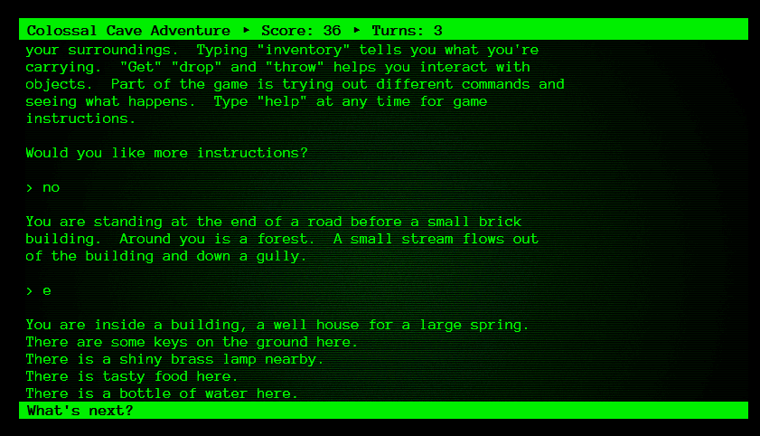
The History

Slide 4
SkyCave is…
… changed as it …
Removes all adventure aspects
‘get lamp’ ‘throw axe’ ‘use key’
Allows modifications to cave which is a (x,y,z) lattice
‘dig n You are in a maze with twisty passages’
Will create a new room, north of this, with the given description
Massive online / distributed system (MMO)
Not one but 10, 1000(!), 1.000.000 (!!!) players
… through horizontal scalable client-server architecture
Single sign-on
Once registered, each player can access every cave

Slide 5
SkyCave is…
… changed as it …
Has some weird features with a learning focus
‘quote’ report a famous quote
Is highly (re)configurable
To support automated testing using test doubles
… and therefore support test-driven development
To support incremental architectural work
HashMap → MongoDB
Local call → HTTP → RabbitMQ
To support architectural testing
Saboteur implementation of central services
To support automated evaluation by me

Slide 6
And Used to…
Learn about
Broker architecture
Implement missing methods in Player
HTTP/Restish architecture
Connect server to subscription, quote services
(and later refactor the whole architecture into microservices)
NoSQL databases
Implement CaveStorage in MongoDB, Redis, Memcached, or …
Container Tech
Pack server into containers, deploy on swarm, …
CI and CD
Automate end-2-end testing and stuff
MS architecture
Refactor a Monolith into a full MS arch doing DevOps with your peers

Slide 7
And…
As one former student put it
Wildly over-engineered architecture ☺
SkyCave is a highly reconfigurable framework
Lots of ‘hotspots’, lots of roles, complex dep injection
SkyCave has history
A few ‘fixme’s still around, a few ‘unused ideas’, etc.
And as always
There may be dragons
Undiscovered bugs, unhealthy naming, old-school java, legacy, …

Slide 8
Software Architecture Sidestep

Slide 9
The 3+1 Viewpoints
+1: Architectural requirements
Deployment Viewpoint
Focus: What physical/virtual nodes are involved, what software is running on each? The physical view
Component Connector Viewpoint
Focus: What processes/objects are executing, how does data and control flow between them? The runtime view
Module Viewpoint
Focus: What compilation units are there, what classes, how are they dependent upon each other? The static view

Slide 10
Deployment and Execution View
Demo!

Slide 11
Demo: Local to Mxx
Start ‘daemon’
Start ‘cmd’
Interact.
Type ‘h’ for help

Slide 12
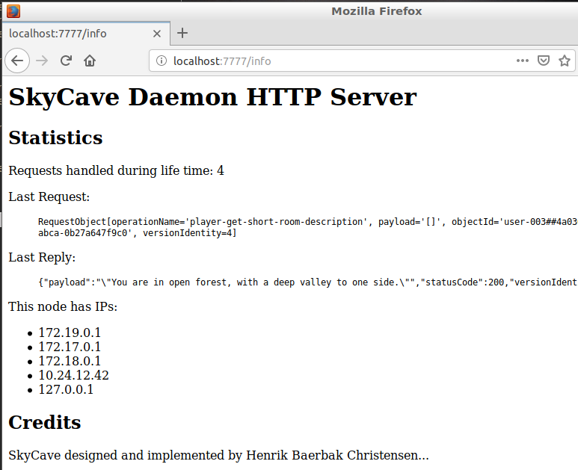
Rudimentary Statistics
Client-server interaction using HTTP on port 7777
Path /info provides some stats to review
Relevant later, when we scale horizontally...

Slide 13
Three Tier Architecture
Three Tier Architecture
Presentation Layer / ‘cmd’
Application Layer / ‘daemon’
A microservice architecture refactoring is a task in the next course ☺
Storage Layer / Database
<<i>>
CaveStorage
Fowler: Monolith First Pattern ☺

Slide 14
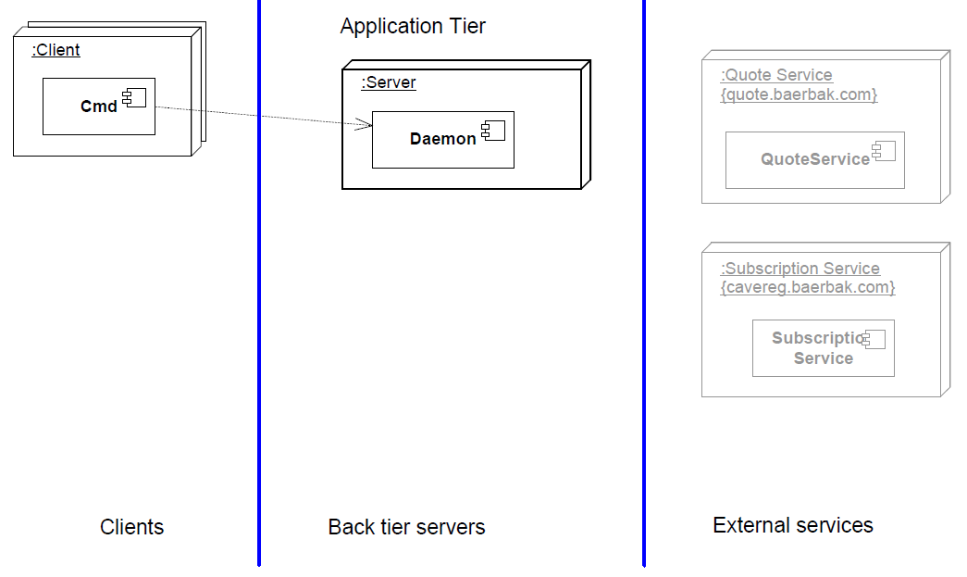
Deployment Viewpoint
The handed out SkyCave (‘http.cpf’)

Slide 15
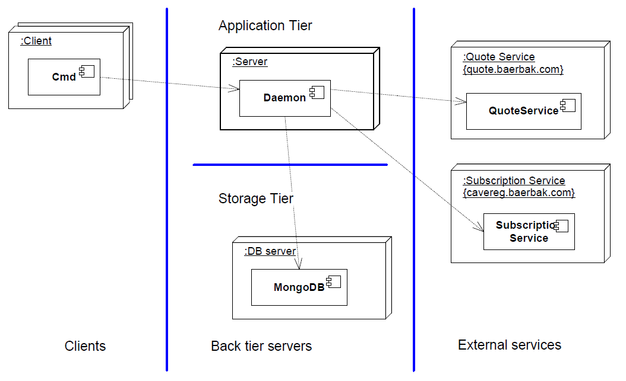
Deployment Viewpoint
The further down the road SkyCave

Slide 16
C&C View
The runtime view

Slide 17
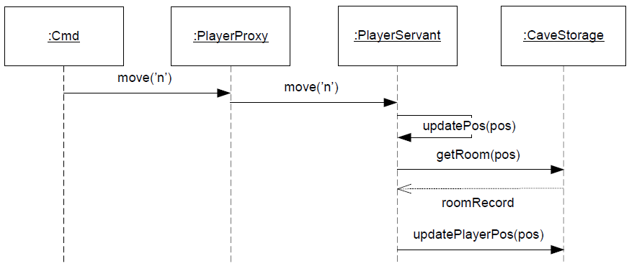
Synchroneous Method Call
Client-server (cmd-daemon) interaction is just Broker based.

Slide 18
Server Side
Server side handling – just interact with persistent storage…

Slide 19
Module View

Slide 20
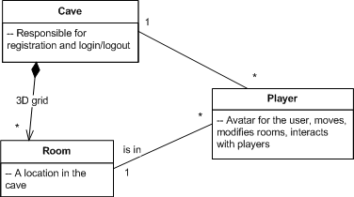
Domain Model
A very simple domain model !
(And a good example of the fact that domain modeling helps very little in designing a strong architecture!)

Slide 21
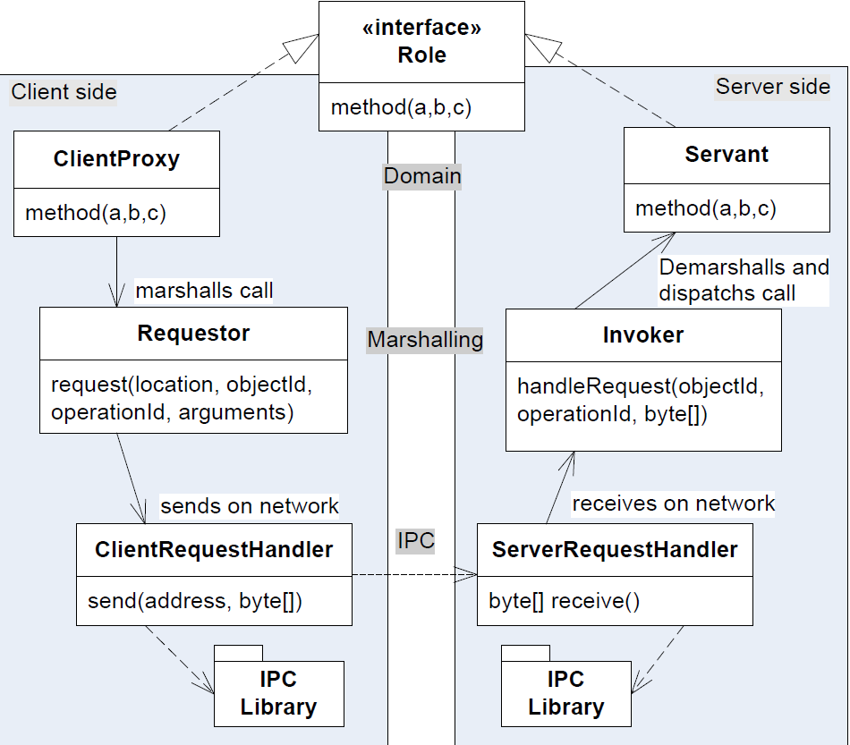
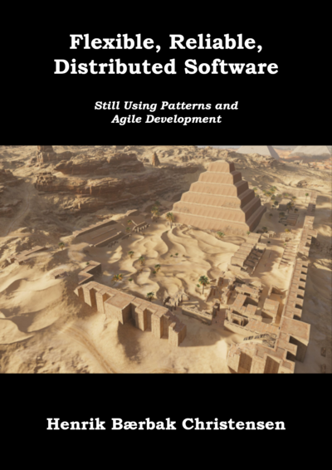
Using FRDS.Broker
Server: PlayerServant, CaveServant
Client: PlayerClientProxy, CaveClientProxy
https://leanpub.com/frds

Slide 22
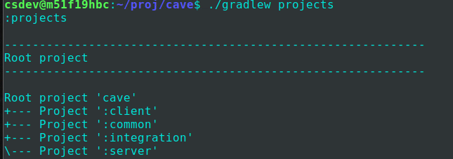
Modules
… are called ‘projects’ in Gradle terminology

Slide 23
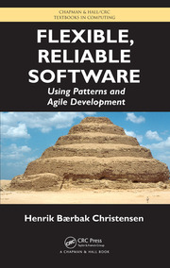
Flexibility
Key Quality I strive for in my books: Flexibility
Core Abstractions
Abstract Factory: Create delegates
ObjectManager: Lookup delegates
Chained Property Files: CPF
Read at start-up…
Defines all
Delegate implementations
Host names and ports

Slide 24
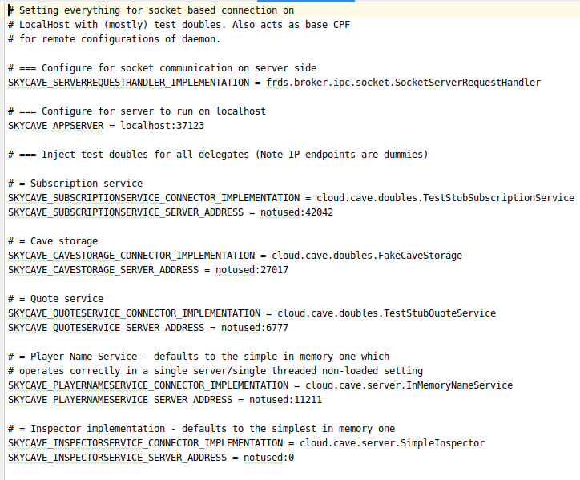
CPF
Example: socket.cpf
Which impl. to use?
Which host:port?

Slide 25
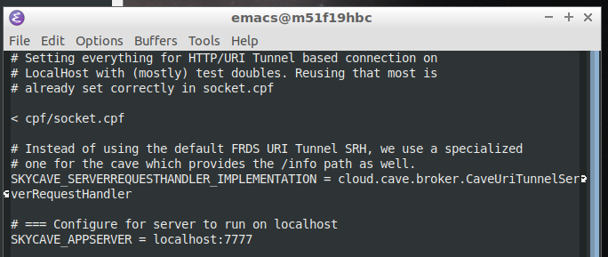
Chaining
We will start by mostly using ‘http.cpf’
Allows defining new configurations that inherit all properties of an ancestor…

Slide 26
Solving Exercises
You must define CPFs for each exercise you solve
‘mongo’ exercise
src/main/resources/cpf/mongo.cpf
Then start your daemon with the proper configuration
gradle daemon –Pcpf=mongo.cpf

Slide 27
Testability
Central for DevOps

Slide 28
Testing and DevOps
Speedy implementation and deployment is central
So, a ‘quality gate’ of 1.000 hour manual tests is no-go
Have automated tests in place for all/most code
I am myself a sworn test-driven development believer ☺
Do no implement anything without having production code covered by tests!!! It is an exam evaluation criteria!

Slide 29
ToolStack

Slide 30
Open Source
It is not a cutting edge programming course, so…
Java 11, Gradle 6, IntelliJ

Slide 31
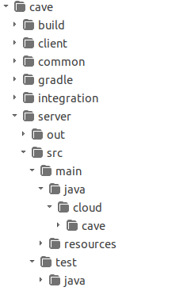
Gradle
Configuration based to a large extend…
Know how the folder structure works!
src/main/java root of production code
src/test/java root of unit test code
src/main/resources root of resources
(the CPFs must reside in ‘cpf/’ subfolder)

Slide 32
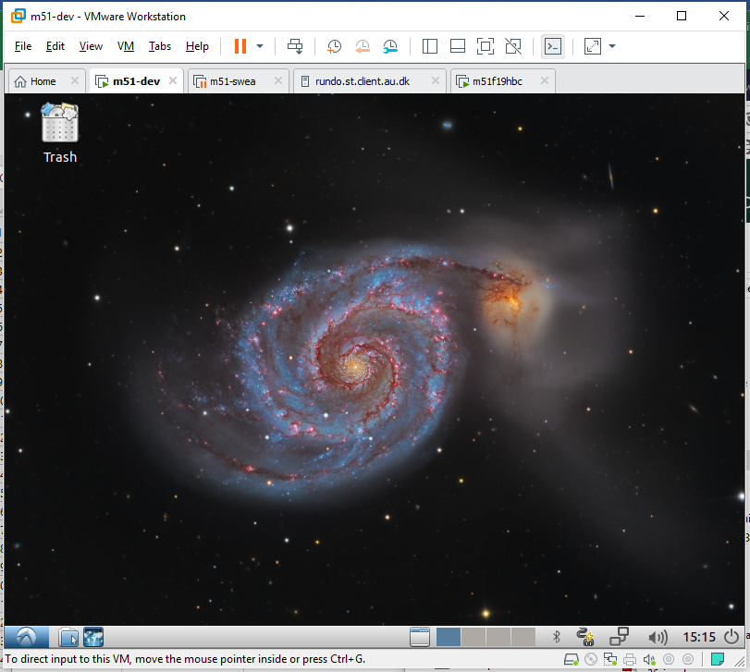
Mxx
Avoid the hazzle of installing everything yourself
And get used to Linux – you will need it for your Docker stuff

